Slide 1


Presidency
Presidency
School of Artificial Intelligence and Advanced Computing

Slide 2
Computer Vision-Based Wildfire Detection Using a Hybrid YoLo Model
CSS7102- Mini Project Review-1
Batch Number:CBD_2
Name of the Student | Roll Number
Maddineni Charan Kumar | 20231CBD0005
Saniya | 20231CBD0015
Arpitha S V | 20231CBD0055
Dhanraj Dhone | 20231CBD0046
Name of the Program: Computer Science & Technology(Big Data)
Name of the HoD: Dr.S.Pravinth Raj
Name of the Program Project Coordinator: Dr.Sameena Banu
Name of the School Project Coordinators: Dr. Sampath A K
Under the Supervision of,
Dr.Vignesh R
Associate Professor (Selecion Grade)
School of Artificial Intllegence and Advance Computing
Presidency University

Slide 3
Content
Problem Statement
Github Link
Analysis of Problem Statement
Timeline of the Project
References

Slide 4
Problem Statement Number: PSAIAC_364
Organization: Presidency University
Category :Software
Problem Description:Wildfires cause over $20 billion in annual global losses and burn millions of hectares of forest each year. Existing systems detect fires but often cannot predict how they will spread. This project uses machine learning to predict wildfire spread using weather, vegetation, and terrain data, helping improve early warning, evacuation planning, and emergency response.

Slide 5
Problem Statement Number: PSAIAC_364
Difficulty Level: High
Reason:
Requires integration of multiple data sources (weather, vegetation, and terrain).
Involves machine learning for predicting wildfire spread accurately.
Needs real-time data processing for timely predictions.
Fire spread depends on dynamic environmental conditions, making prediction challenging.
Requires balancing prediction accuracy with fast emergency response.

Slide 6
Github Link
GitHub Repository:
ML-Based Wildfire Spread Prediction
Repository Description: An AI-powered wildfire spread prediction system that leverages machine learning to estimate wildfire direction and risk using weather, vegetation, and terrain data. The project aims to support early warning, evacuation planning, and emergency response through intelligent wildfire analysis.

Slide 7
Analysis of Problem Statement
Technology Stack Components:
Component | Technology Used
ML Model | XGBoost
Fire Detection | Hybrid YoLoV26(Proposing Model)
Programming Language | Python 3.11+
Backend | FastAPI
Frontend | React.js
Database | PostgreSQL
Weather API | OpenWeatherMap
Version Control | Git & GitHub
Deployment | Render

Slide 8
Analysis of Problem Statement (contd...)
Increasing Wildfire Incidents: Climate change and extreme weather conditions have increased the frequency and intensity of wildfires worldwide.
High Economic & Environmental Impact: Wildfires cause over $20 billion in annual losses and destroy millions of hectares of forests, affecting biodiversity and human lives.
Limitations of Existing Systems: Most current solutions focus on fire detection but lack accurate wildfire spread prediction capabilities.
Need for Intelligent Prediction: Predicting the direction and speed of wildfire spread using weather, vegetation, and terrain data enables faster emergency response.
AI-Based Solution: Machine learning can analyze environmental factors to forecast wildfire spread, helping authorities improve evacuation planning and resource allocation.

Slide 9
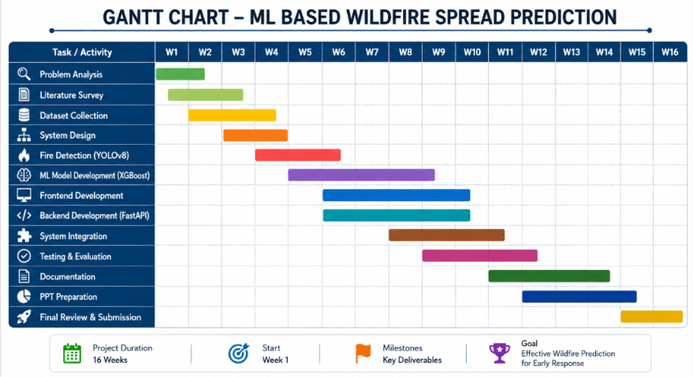
Timeline of the Project (Gantt Chart)

Slide 10
References (IEEE Paper format)
Wang, M., Yue, P., Jiang, L., et al., "An Open Flame and Smoke Detection Dataset for Deep Learning in Remote Sensing Based Fire Detection," Geo-spatial Information Science, 2025.
🔗 https://doi.org/10.1080/10095020.2024.2347922
Polenakis, I., Sarantidis, C., and Karydis, I., "Benchmarking Next-Generation YOLO Architectures for Multi-Platform Forest Fire Recognition," Electronics, 2026.
🔗 https://doi.org/10.3390/electronics15132830
Ma, S., Hui, Y., Zhang, Y., and Wu, Y., "A Lightweight and Sustainable UAV-Based Forest Fire Detection Algorithm Based on an Improved YOLO11 Model," Sustainability, 2026.
🔗 https://doi.org/10.3390/su180
Guo, B., Liu, D., Shen, Z., and Wang, T., "FF-Mamba-YOLO: An SSM-Based Benchmark for Forest Fire Detection in UAV Remote Sensing Images," Journal of Imaging, 2026.
🔗 https://doi.org/10.3390/jimaging12010043

Slide 11


